Slide 1
Are You Zoophilist?

Slide 2
Wildlife rescue database
wildlife rescuers
rescued animals
caller’s info
user

Slide 3
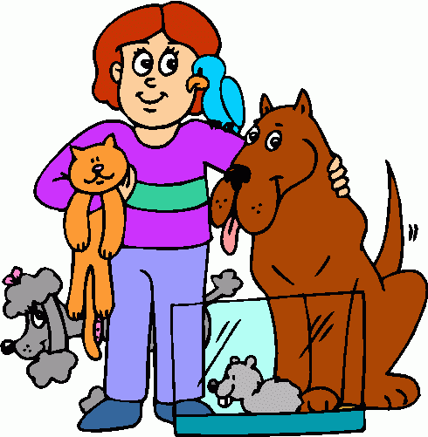
INTRODUCTION
This Database is design for Animal Rescue this will help to stores the records of rescued animals and activities of rescuers and we can easily store, manage and manipulates that Records or DATA.
THIS DATABASE of the system will store Information about RESCUERS,RESCUED ANIMALS,CALLERS and USERS automatically through Mobile Application (APP.)

Slide 4
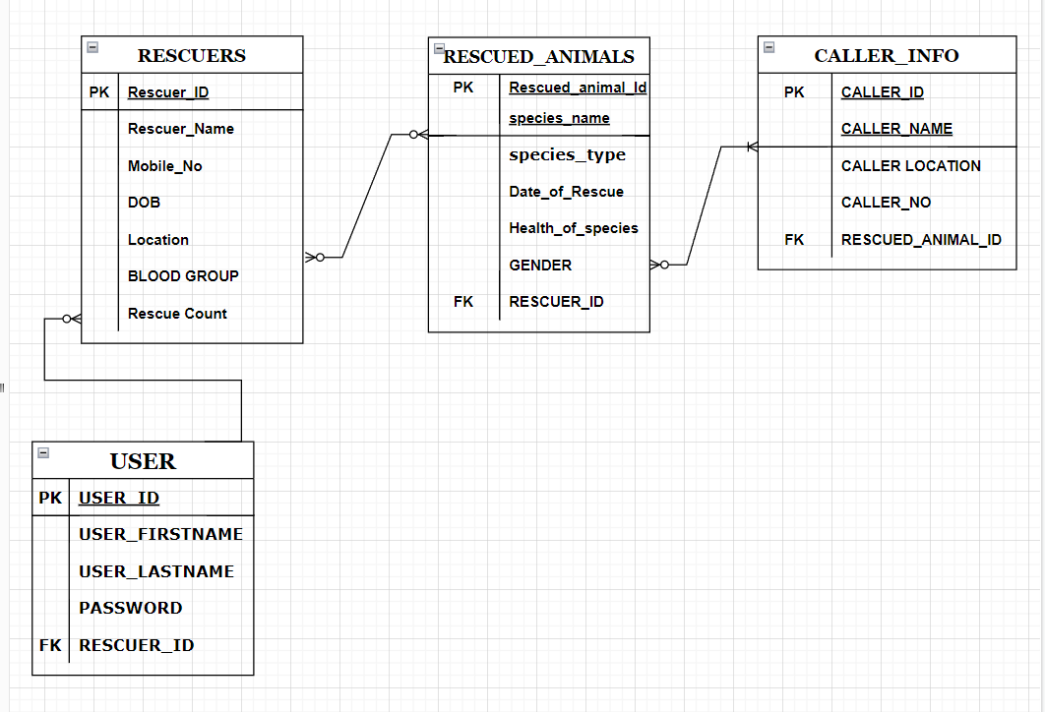
ENTITY RELATIONSHIP DIAGRAM(ERD)
Graphical Representation of the DATABASE Name as WILD_RESCUE.

Slide 5
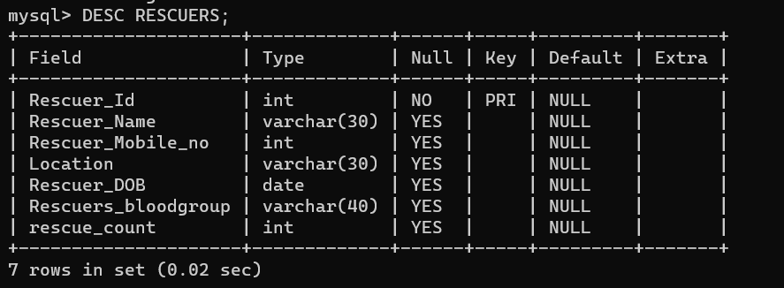
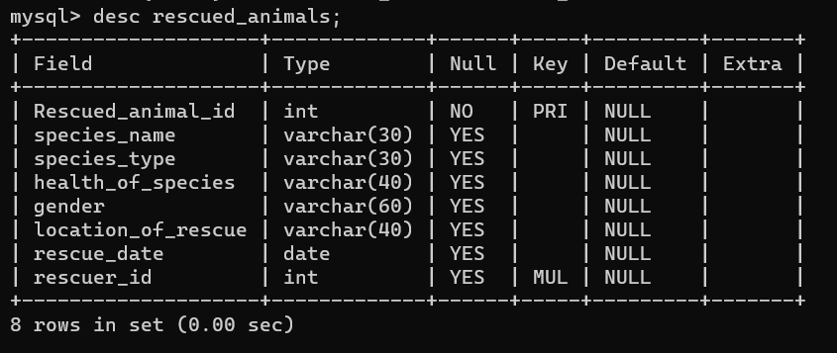
STRUCTURES OF TABLES
We can know the Columns Name,Column Count,Datatype of column,Applied Keys,etc. of Tables through this DESC Query.

Slide 6
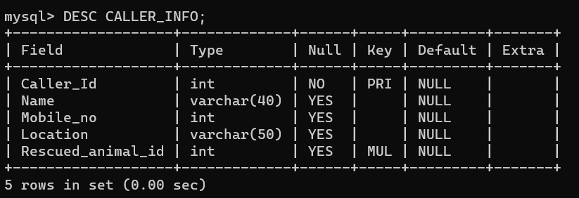
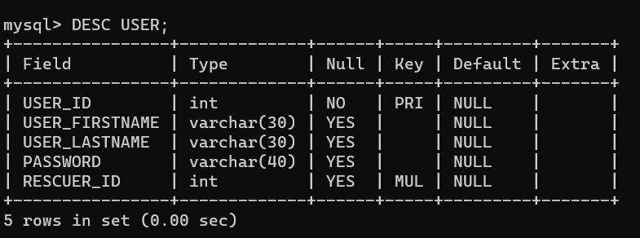

Slide 7
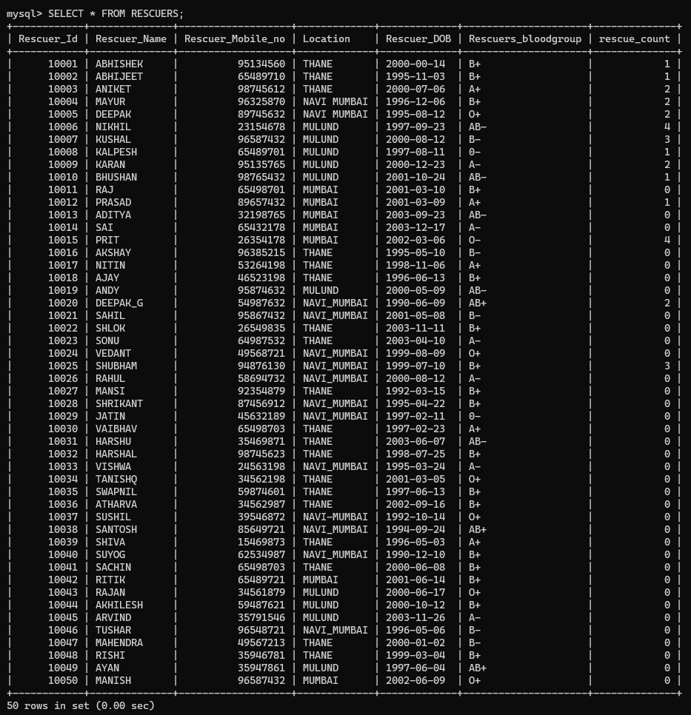
This TABLE SHOWS THe INFORMATIONS ABOUT WILDLIFE RESCUERS.

Slide 8
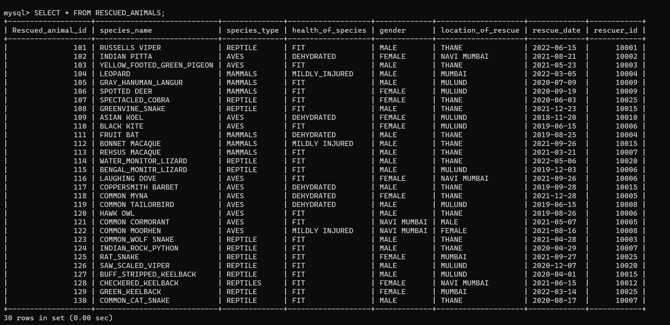
THIS TABLE SHOWS THE ALL INFORMATION RELATED TO ANIMALS WHO WHERE RESCUED BY RESCUERS.

Slide 9
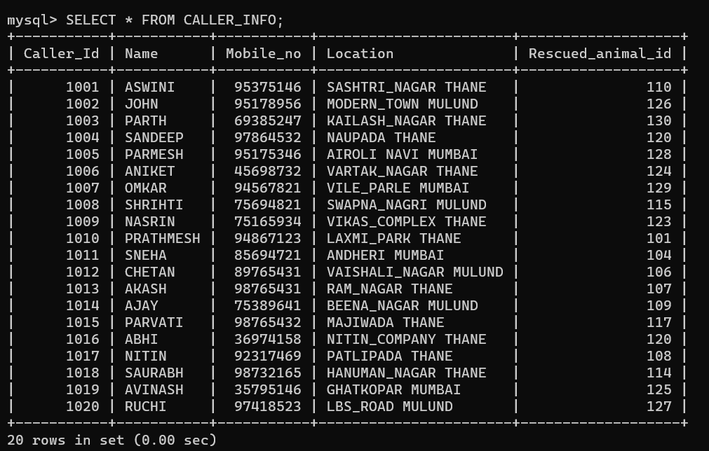
THIS TABLE SHOWS THE INFORMATION ABOUT THE CALLERS WHO WHERE CALLED THE RESCUERS FOR SICK & INJURED ANIMALS.

Slide 10
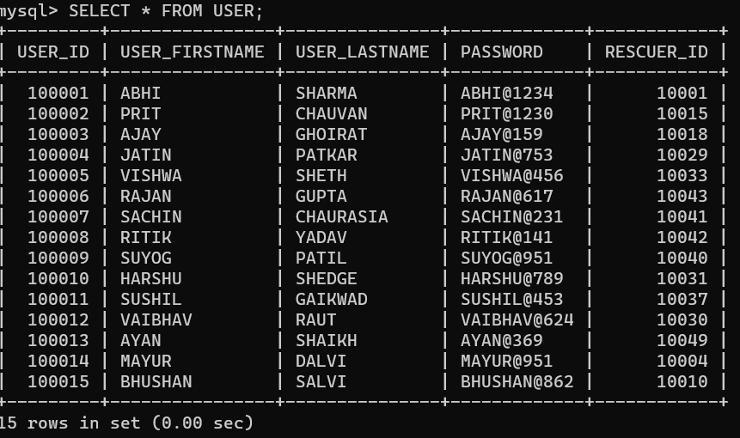
THIS TABLE SHOWS THE INFORMATION ABOUT USERS WHO CAN ACCESS AND USE THE MOBILE APPLICATION.

Slide 11
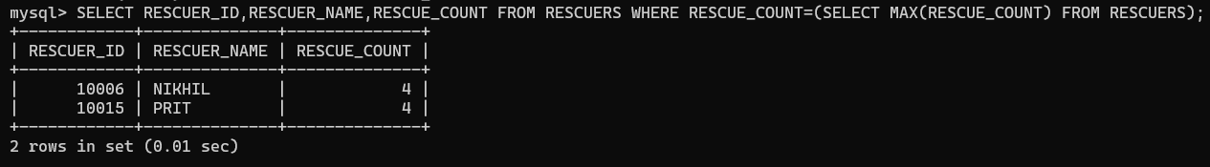
SINGLE ROW SUBQUERIES
When we Want to Find out the Any RESCUE_COUNT of RESCUERS we can Use This SUBQUERY.

Slide 12
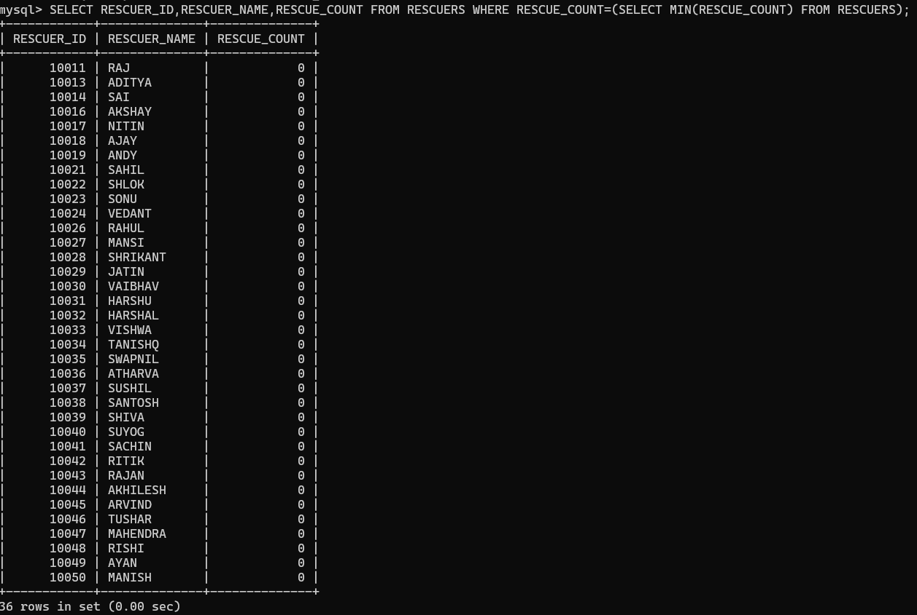
When we Want to Find Out the Minimum RESCUE_COUNT of the RESCUERS then we can use This SUBQUERY.

Slide 13
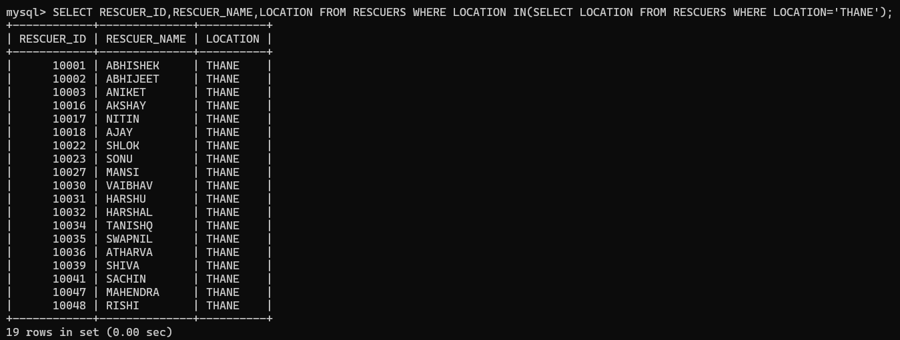
MULTIPLE ROW SUBQUERIES
When we want to Find Out The List of The RESCUERS WHO WHERE STAY IN SAME CITY. We can USE This SUBQUERY.

Slide 14
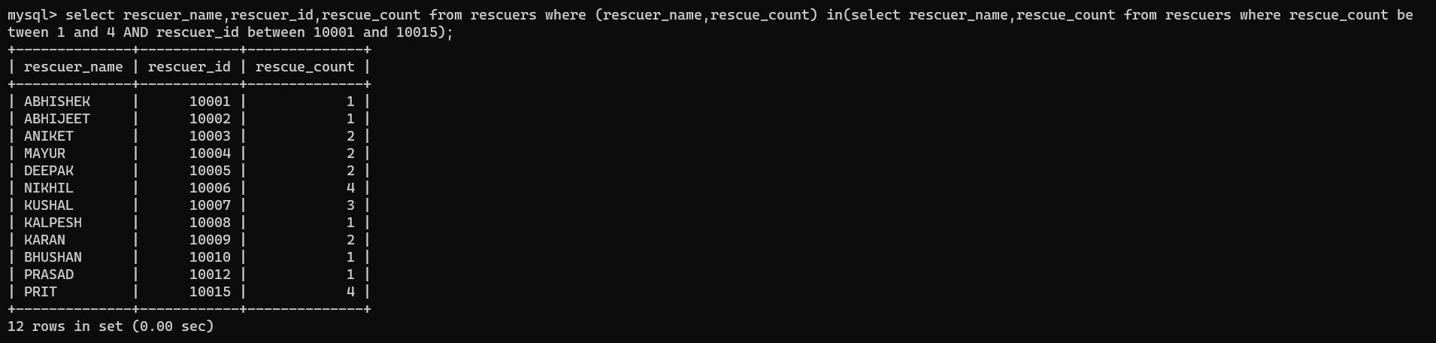
MULTIPLE COLUMN SUBQUERIES
When we want to Find Out The Specific RESCUE COUNT of Particular RESCUERS at that time we can Use This SUBQUERY.(Returns The Records from Both COLUMN).

Slide 15
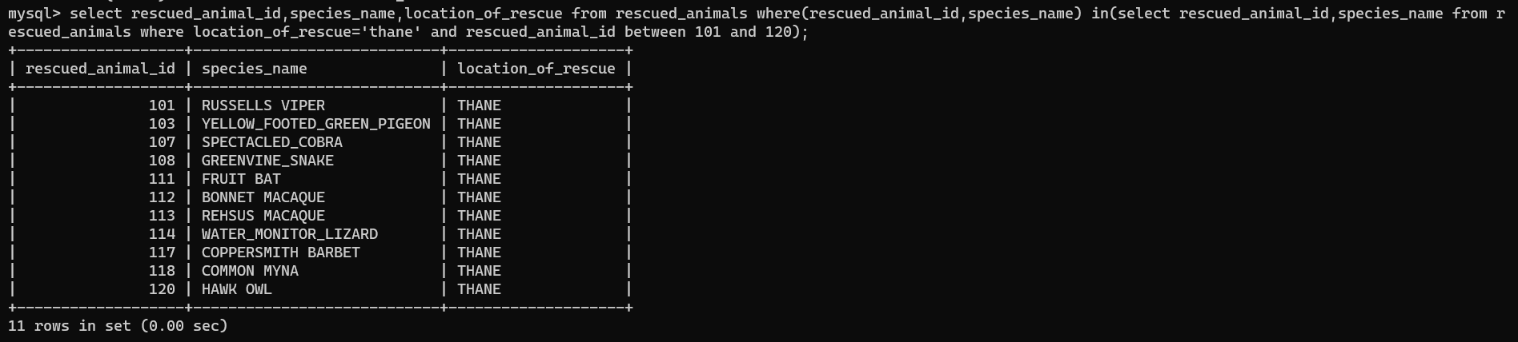
When we Want to Find Out The Details of Specific RESCUED ANIMALS from Same Location of Rescue then we can use this SUBQUERY.

Slide 16
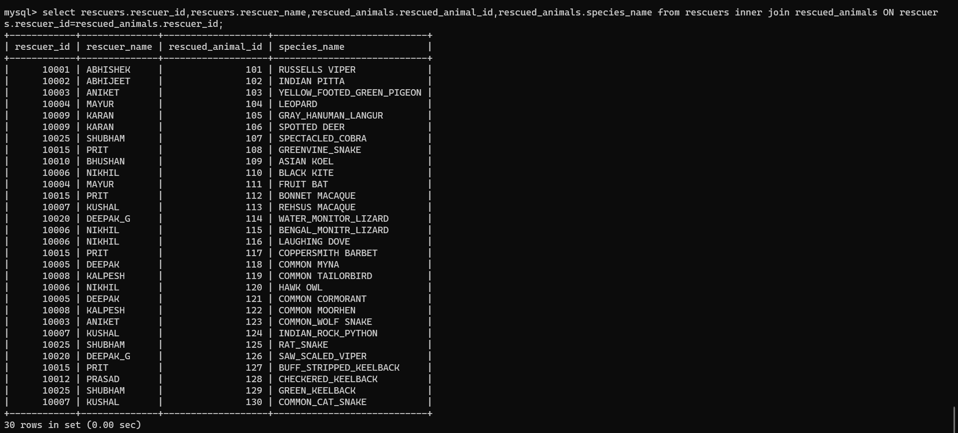
JOINS
When we Want to Know the Similar Records from Two Different Tables then we can Use This INNER JOIN.

Slide 17
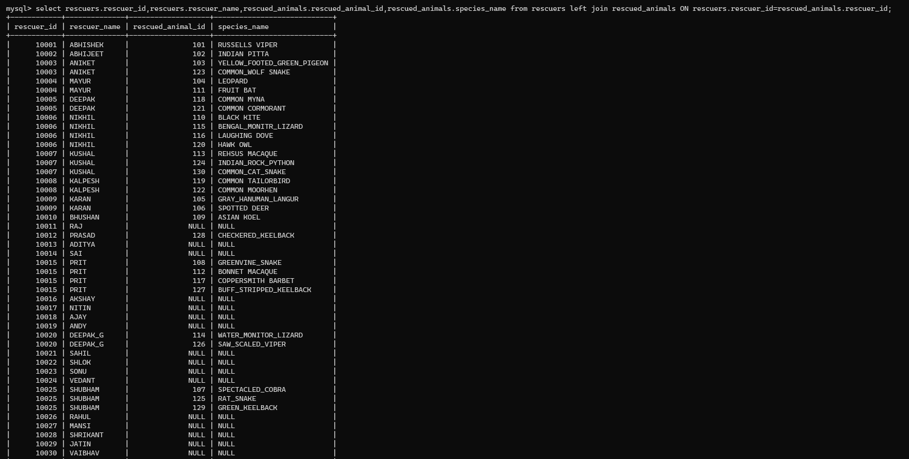
When we Want Whole Records Left Table & Only Similar Records from Right Tables then we can use This LEFT JOIN.

Slide 18
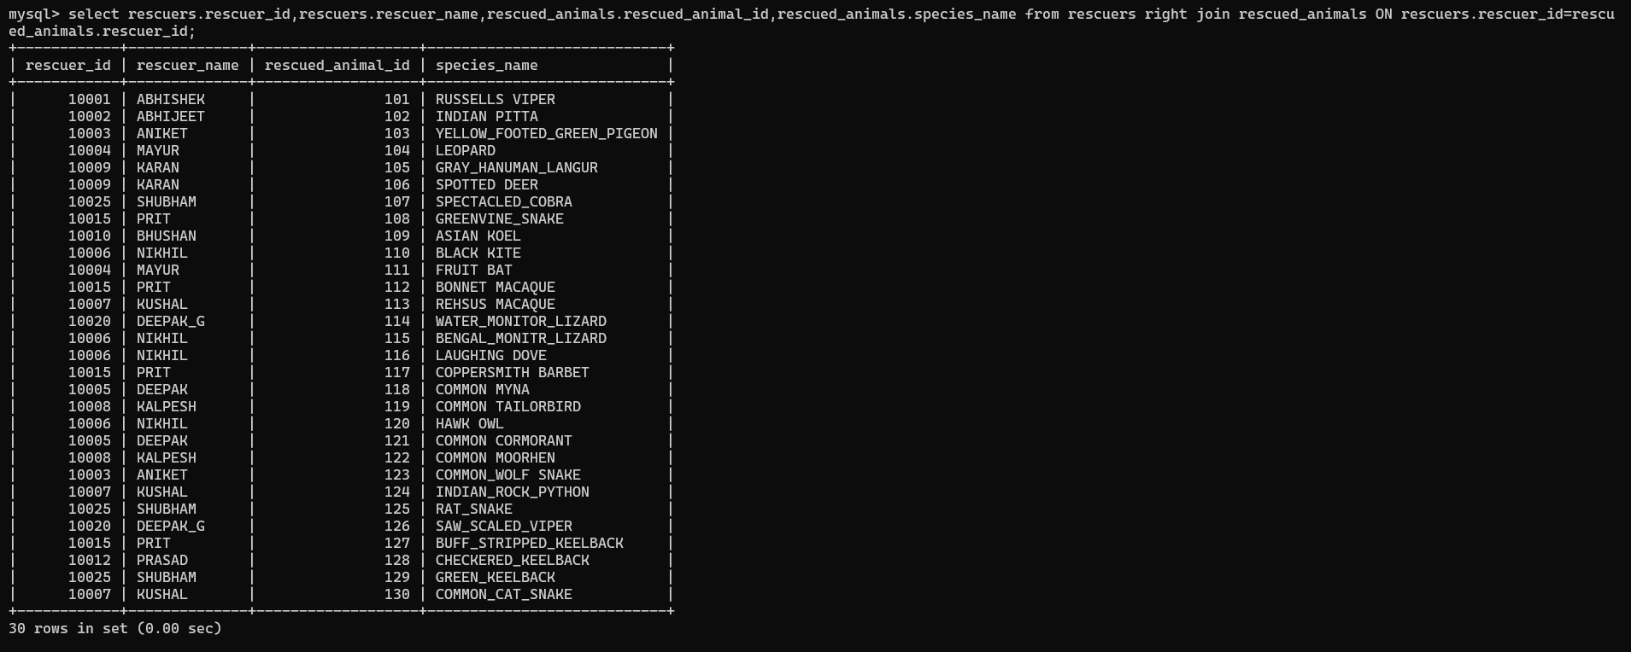
When we Want the Whole Records from Right Table & Only Similar Records from Left Tables then we can Use this RIGHT JOIN.

Slide 19
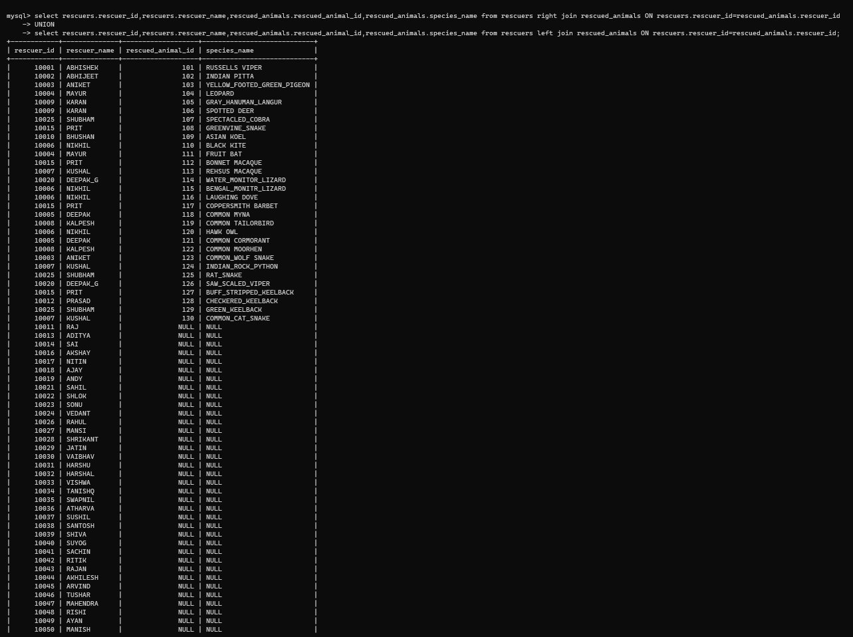
When we Want Whole Records from Left & Right Tables then we can Use this FULL JOIN.

Slide 20
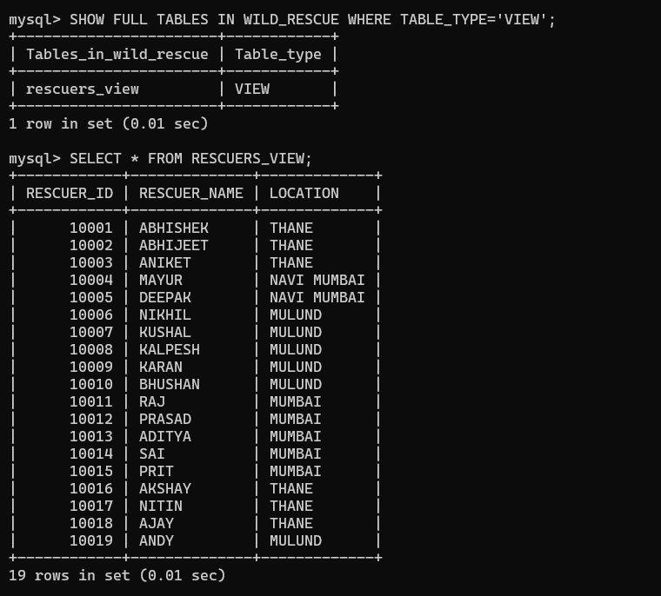
VIEWS
When we Want Selective and Specific DATA from Rows & Colums from One or Many Tables then we can Create VIEW to Extract the Specific DATA that we Want.

Slide 21
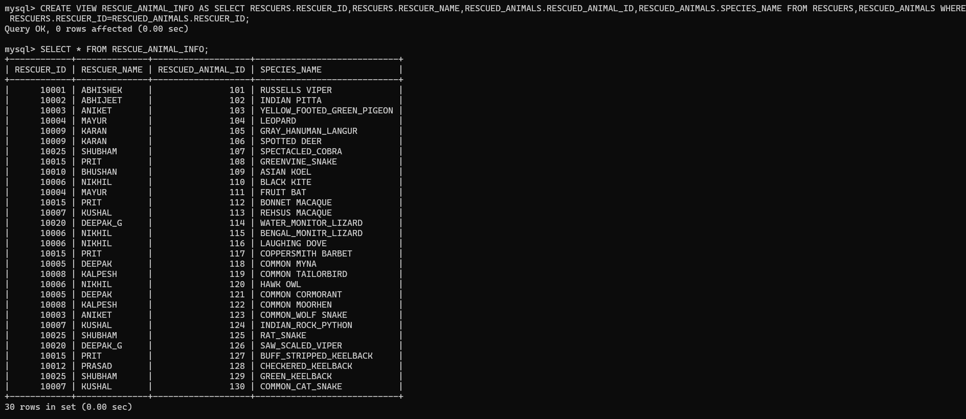

Slide 22
THANK
YOU !!!

